Slide 1

Steps
to
clustering
1344 indicators
Filtering
Topics
PCA
Clustering

Slide 2
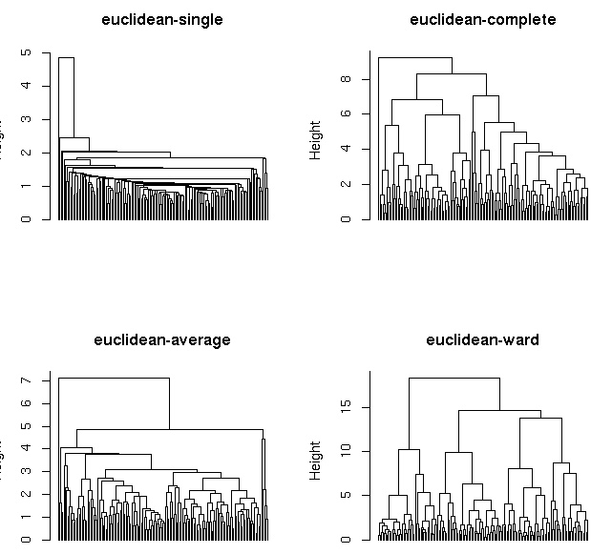
No Hierarchical

Slide 3
Clustering
Stability
K Means
k found
quantitatively
&
qualitatively
Real results

Slide 4
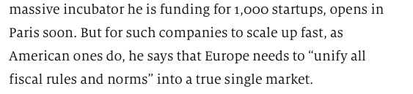
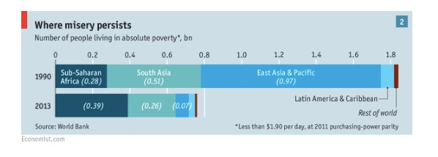


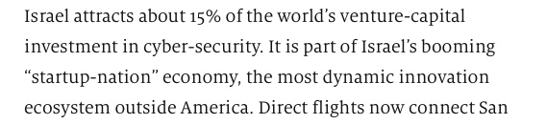
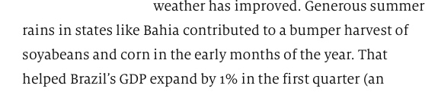

From
“The Economist”
“
”
“
”
“
”
“
“
”
”
“
”

Slide 5
Discrimination
Analysis
No Gaussianity
FDA
KNN
Centroids
&
Components
Prediction
Prediction

Slide 6
Should we use FDA or KNN?
 | APERCV K-Means | APERCV FDA
Agricolture | 0.1275 | 0.2617
Economic indicators | 0.0712 | 0.1905
Ease to start a business | 0.0643 | 0.1462
Natural resources | 0.0393 | 0.0561
Production | 0.0559 | 0.3230
Telecommunication | 0.0653 | 0.0151
Trade | 0.1361 | 0.0651

